Slide 1
Chapter 6:
The Stack Abstract Data Type
Data Structures in Java: From Abstract Data Types to the Java Collections Framework
by Simon Gray

Slide 2
Introduction
Examples of Stack usage:
  Browser “back” button: takes you to the page visited before the current page
  Editor “undo” button: takes you to the state of the document before the current state
  Process stacks: stores call frames to support method calls. The call frame on top of the stack is the currently executing method, the call frame below it represents the method invoked before the current method, and so on
Stack: a Last-In-First-Out (LIFO) data structure – the last item into the stack is the first out of it
  Attributes: top – references the element on top of the stack
  Operations: push(element), pop(), peek(), isEmpty(), size()

Slide 3
Stack Properties and Attributes
Properties
Stacks are LIFO data structures. All accesses are done to the element referenced by top.
The top always refers to the topmost element in the stack.
Insertions are done “above” the top element.
Attributes
size : The number of elements in the stack: size >= 0 at all times.
top : The topmost element of the stack, refers to null, a special value indicating top doesn’t reference anything in the stack.

Slide 4
Stack Operations
Stack()
pre-condition: none
responsibilities: constructor – initialize the stack attributes
post-condition: size is 0
top refers to null (a special value not part of
the stack)
returns: nothing
push( Type )
pre-condition: none
responsibilities: push element onto the top of the stack
post-condition: element is placed on top of the stack
size is incremented by 1
top refers to the element pushed
returns: nothing

Slide 5
Stack Operations
pop()
pre-condition: isEmpty() is false
responsibilities: remove and return the element at top
post-condition: the top element is no longer in the stack
size is decremented by 1
top refers to the element below the previous
topmost element or null if the stack is empty
returns: the element removed
throws: empty stack exception if pre-condition is not
met

Slide 6
Stack Operations
peek()
pre-condition: isEmpty() is false
responsibilities: return the element at top
post-condition: the stack is unchanged
returns: the element referenced by top
throws: empty stack exception if pre-condition is not
met

Slide 7
Behavior of Stack’s operations
Method | Purpose | Object State | Returned Value
Stack<String> s = new LinkedStack<String>() | Create an empty stack s | size = 0 top = null | a LinkedStack object for Strings
s.push (“A”) | Add“A” to stack s | size = 1 “A” top
s.push (“B”) | Add “B” to stack s | size = 2 “A” “B” top
String str = s.peek() | Peek at the top element of stack s |  | “B”
str = s.pop() | Pop top element from stack s | size = 1 “A” top | “B”
s.isEmpty() | See if the stack s is empty |  | false
str = s.pop() | Pop top element from stack s | size = 0 top = null | “A”
s.isEmpty() | See if the stack s is empty |  | true
str = s.peek() | Peek at the top element of stack s |  | exception

Slide 8
Designing a Test Plan
Ask questions!
What are the bounds for this collection type?
  empty? full? not empty and not full? one element? one element away from being full? (off-by-1checks!)
How does each operation change the state of the stack?
  Should come from operations description and pre-conditions – the specification is important!
What are the invalid conditions that must be caught?
  Should come from operations pre-conditions and throws descriptions
Designing test cases helps clarify the specification. You can’t start coding until you are clear about the behavior of the operations!

Slide 9
Test Case 6.2: Pushing onto a Stack
Method | Purpose | Object State | Expected Result
Stack<String> s = new ListStack<String>() | Create an empty stack | size = 0 top = null position | a ListStack for Strings
s.push(“www.nps.gov”) | Push onto an empty stack | size = 1 top = “www.nps.gov”
s.size() | Verify new stack state |  | 1
s.isEmpty() | Verify new stack state |  | false
String str = s.peek() | Verify new stack state |  | “www.nps.gov”
s.push(“www.nasa.gov”) | Push onto a non-empty stack | size = 2 top = “www.nasa.gov” www.nps.gov”
s.size() | Verify new stack state |  | 2
str = s.peek() | Verify new stack state |  | “www. nasa.gov”
s.push(“www.bls.gov”) | Push onto a non-empty stack | size = 3 top = “www.bls.gov” “www.nasa.gov” “www.nps.gov”
s.size() | Verify new stack state |  | 3
str = s.peek() | Verify new stack state |  | “www.bls.gov”

Slide 10
Adapter Design Pattern
Problem:
Need to create a class that implements the API defined in an interface we are given. We know of an existing class that offers some or all of the functionality described by the target interface we need to implement, but the existing class has a different API

Slide 11
Adapter Design Pattern: Description
The Adapter design pattern solves this problem by adapting the API
of the existing class to that of the target interface. The basic steps
are as follows – see the figure on the next slide
Define an adapter class, (here called AdapterClass, but the actual name doesn’t matter) that implements the target interface
Methods in the target interface are matched with counterparts in the existing class (called ExistingClass here) that provide the same general behavior
An instance of ExistingClass is included in AdapterClass through composition
The methods in AdapterClass simply forward the message to the corresponding method in ExistingClass. This is called message forwarding

Slide 12
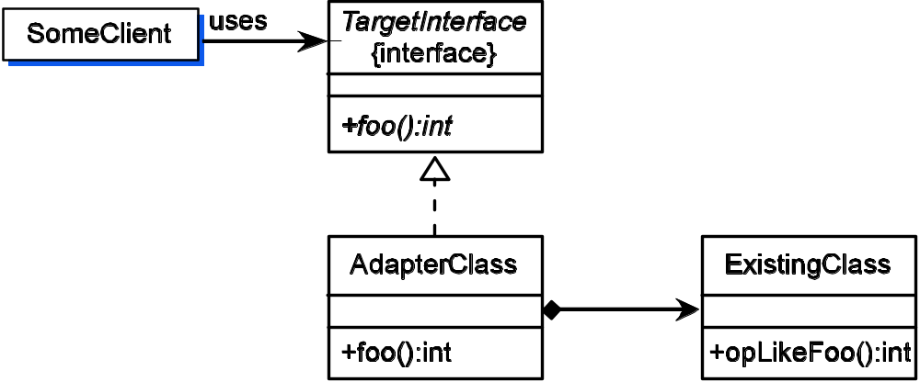
Adapter Design Pattern: UML Diagram

Slide 13
Adapter Design Pattern: Consequences
The adapter pattern allows you to quickly implement a new class by reusing an existing class that provides at least some of the behavior needed, but through a different API. This is especially useful for rapid development of prototypes, when execution speed is not an issue
There is a performance cost. The indirection introduced by the message forwarding from the AdapterClass object to the ExistingClass object requires additional time
The API of ExistingClass is visible only to AdapterClass and is completely hidden from the client

Slide 14
ListStack: Applying the Adapter Pattern
Tasks to complete to implement a Stack using a List
as the backing store:
Determine whether a field from List can take on the responsibility of an attribute or method from Stack
Determine which methods from List can provide the behavior defined by methods from Stack
Implement the Stack methods using the information gathered in the first two tasks

Slide 15
Map Stack Attributes to List Attributes and/or Methods
Remember, an attribute can be stored or synthesized from other information available
Stack.size maps nicely to List.size
Stack.top – all accesses to a stack are at its top, which we can picture as one end of a linear structure. Where are List accesses most efficient?

Slide 16
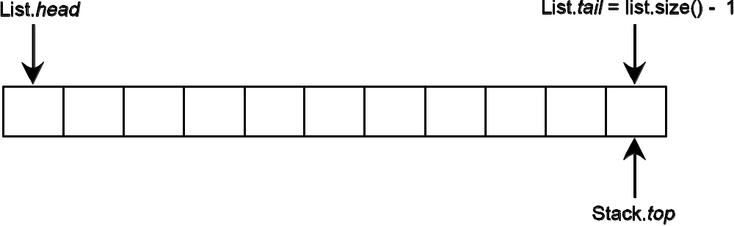
Map Stack Attributes to List Attributes and/or Methods
Stack Attribute | List Equivalent
top | size() – 1
size | size()
Don’t underestimate the importance of doing this
mapping first. Careful planning saves time later!

Slide 17
Map Stack Methods to List Methods
A consequence of the attribute mapping is that a push op results in appending to the List
size() – 1 + 1 = size()
tail of
list
next position beyond tail
location to “push” the new stack element
Stack operation | List operation equivalent
push( element ) | add( size(), element )
E pop() | E remove( size() - 1 )
E top() | E get( size() – 1 )
int size() | int size()
boolean isEmpty() | boolean isEmpty()

Slide 18
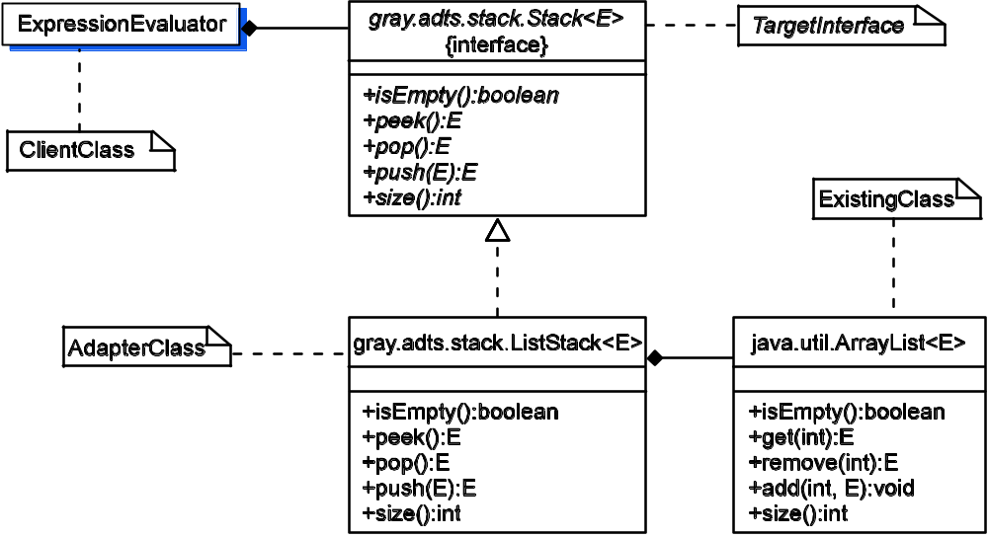
ListStack: The UML Diagram
Compare this to the UML diagram for the Adapter Design Pattern

Slide 19
What does the implementation look like?
1 package gray.adts.stack;
2
3 import java.util.LinkedList;
4 import java.util.List;
5 import java.util.EmptyStackException;
6
7 /**
8 * An implementation of the Stack interface using a list as the
9 * underlying data structure.
10 */
11 public class ListStack<E> implements Stack<E> {
12 private java.util.List<E> stack;
13 // the top element of stack is stored at position
14 // s.size() - 1 in the list.
15
16 /**
17 * Create an empty stack.
18 */
19 public ListStack() {
20 stack = new LinkedList();
21 }
22
Note the use of comments
to help me remember
important details
The “stack” is really
a List; put another way,
the stack’s elements will
be stored in a List

Slide 20
What does the implementation look like?
23 /**
24 * Determine if the stack is empty.
25 * @return <tt>true</tt> if the stack is empty,
26 * otherwise return <tt>false</tt>.
27 */
28 public boolean isEmpty()
29 {
30 return stack.isEmpty();
31 }
32
33 /**
34 * Return the top element of the stack without removing it.
35 * This operation does not modify the stack.
36 * @return topmost element of the stack.
37 * @throws EmptyStackException if the stack is empty.
38 */
39 public E peek()
40 {
41 if ( stack.isEmpty() )
42 throw new EmptyStackException();
43 return stack.get( stack.size() - 1 ) ;
44 }
message forwarding – let
the List object do all the
work
Having done the attribute
mapping, this is easy to
figure out

Slide 21
What does the implementation look like?
46 /**
47 * Pop the top element from the stack and return it.
48 * @return topmost element of the stack.
49 * @throws EmptyStackException if the stack is empty.
50 */
51 public E pop()
52 {
53 if ( stack.isEmpty() )
54 throw new EmptyStackException();
55 return stack.remove( stack.size() - 1 );
56 }
57
58 /**
59 * Push <tt>element</tt> on top of the stack.
60 * @param element the element to be pushed on the stack.
61 */
62 public void push( E element)
63 {
64 stack.add( stack.size(), element );
65 }
Compare with peek()
List.size() -1 is top,
so “push” new element
at List.size()

Slide 22
A Linked Implementation of Stack
Task list:
Decide which linked structure representation to use: singly linked list or doubly linked list
Map the Stack ADT attributes to a linked list implementation. In doing this we will identify the data fields our class will need
Implement the Stack ADT operations as methods in our class

Slide 23
Singly or Doubly Linked List?
How do we decide?
What are the salient characteristics of a Stack?
  All accesses are at the top
Don’t need the additional complexity of a doubly linked list
⇒ a singly linked list will do

Slide 24
Map Stack ADT attributes to a linked list implementation
A linked list is a linear structure. Which end should be the top?
  Where is it easiest and most efficient to do inserts and deletes? At the head of the linked list
  top will refer to the head of the linked list
Use a dummy node for the head to simplify inserts/deletes at the head
⇒ top will refer to a dummy node representing the
head of the linked list

Slide 25
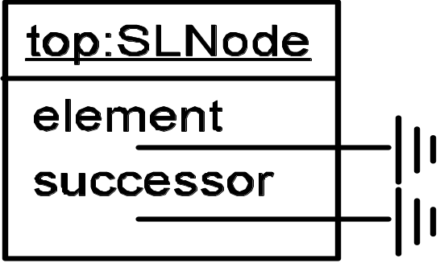
Map Stack ADT attributes to a linked list implementation
public class LinkedStack<E> implements Stack<E> {
private int size;
private SLNode<E> top;
top:
An empty LinkedStack using
a dummy node for top
top

Slide 26
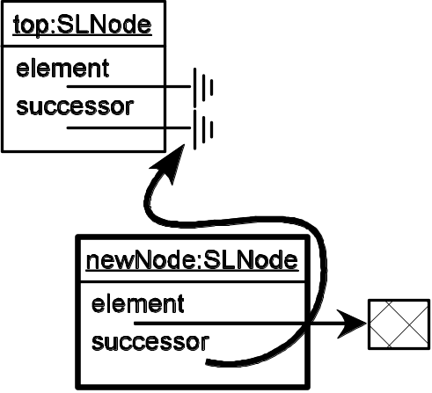
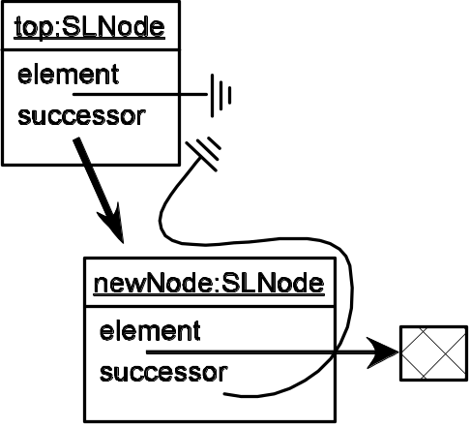
The push() operation
1. create a new SLNode (a)
2. Set the new node’s successor field to be
  the same as top’s next field (b)
  3. Set top’s successor field to reference the
  new node. (c)
4. Increment size by 1
1 public void push( E element ) {
2
3 SLNode newNode =
4 new SLNode<E>(element,
5 top.getSuccessor()); (a, b)
6
7 top.setSuccessor( newNode ); (c)
8
9 size++;
10 }
Pushing an element
onto an empty stack
Steps (a) and (b)
Step (c)

Slide 27
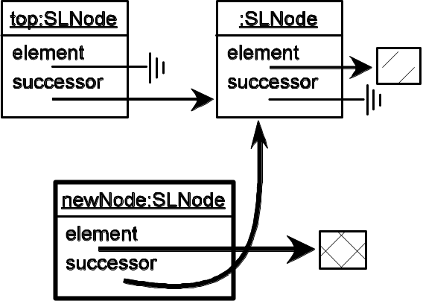
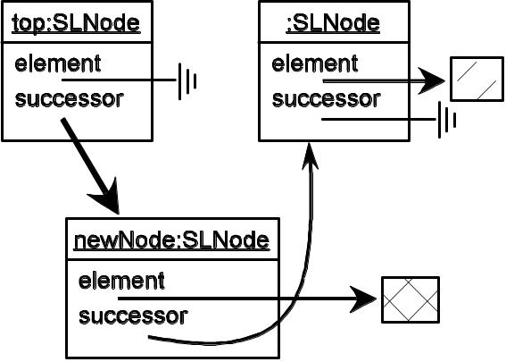
The push() operation
1. create a new SLNode (a)
2. Set the new node’s successor field to be
  the same as top’s next field (b)
  3. Set top’s successor field to reference the
  new node. (c)
4. Increment size by 1
1 public void push( E element ) {
2
3 SLNode newNode =
4 new SLNode<E>(element,
5 top.getSuccessor()); (a, b)
6
7 top.setSuccessor( newNode ); (c)
8
9 size++;
10 }
Pushing an element
onto a non-empty
stack
Steps (a) and (b)
Step (c)

Slide 28
Implementing the Test Plan
One of the advantages of using the Adapter design pattern is that we get to use software that has already been tested, so most of the Stack testing is reduced to seeing that we have used the representation data structure (List) properly.
Testing must focus on the associations made between Stack attributes and methods, and how they are represented using the List (e.g., Stack’s top and List’s size() - 1)

Slide 29
Implementing the Test Plan
The pop() and peek() operations in Test Case 6.1 should generate exceptions, since trying to look at the top of an empty stack is meaningless. How to do this in JUnit? Use a try-catch block!
1 public void testPopEmpty() {
2 Stack s = new ListStack();
3
4 try {
5 s.pop();
6 }catch ( EmptyStackException ex ) {
7 return; // this is what we expect
8 }
9 // if we get here – the test failed :-(
10 fail("testPopEmpty: EmptyStackException expected");
11 }

Slide 30
Implementation Evaluation
Stack Operation | List Operation | Cost
push( element ) | add( size(), element ) | Ο(1)
pop() | remove( size() – 1 ) | Ο(1)
top() | get( size() – 1 ) | Ο(1)
The cost of Stack operations for the Adapter
implementation using a List

